Slide 1



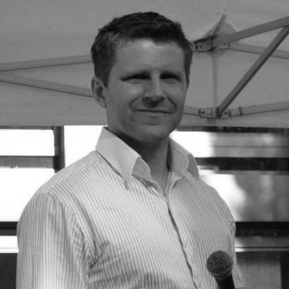
Dr. Bastian Brand – Mission Lead
Professional experience
Education and skills
5 years at McKinsey & Company, Munich with a focus on corporate finance serving private equity funds and companies in basic industries (chemicals, oil & gas) and retail, e.g.
Redefined the capex strategy of a Global producer of agrochemicals and plant seeds
Evaluated the prospects of creating a medical treatment and education center in Riyadh, KSA
Co-led the development of an expert team on the capital markets and financial performance of chemical and oil & gas companies in Munich, Amsterdam and Sao Paulo
3 years as an entrepreneur in eCommerce & Fintech
Co-founding of an e-Commerce gift shop Developed the product and content, and drove marketing and user-support
Co-founded a VC fund for blockchain companies Created an investment strategy and reached out to investment targets at industry events
3 years at Goetz Partners, Munich and as a freelancer
Completed commercial due diligence projects in the consumer goods and construction industries
Gave expertise to reorganize the finance function of an eCommerce company preparing for a VC funding round
Bastian holds a Ph.D. and MSc degree in Business Administration from the University of Frankfurt and Mainz, Germany; he has focused on finance & law and management accounting; in addition Bastian is a CFA charter holder
He also holds a a MSc degree in European Studies from the University of Bath and the Institut d’Études Politique (IEP), Paris with a specialization in regulation and supranational environmental policy-making
Bastian speaks German and English fluently and is able to have professional conversations in French. He has basic knowledge in Spanish and Russian
Introduction
International focus and passion to turn innovative business models into a reality
Specialist on strategy development and corporate finance
Sector expertise in basic industries, tech and retail/ecommerce

